Slide 1


Early Italian Immigration
to Canada

Slide 2
What does pizza have to do with immigration history?

Slide 3
Think-Pair-Share
What do you notice?
Who is in the images?
What is the setting, and what are the people doing?

Slide 4
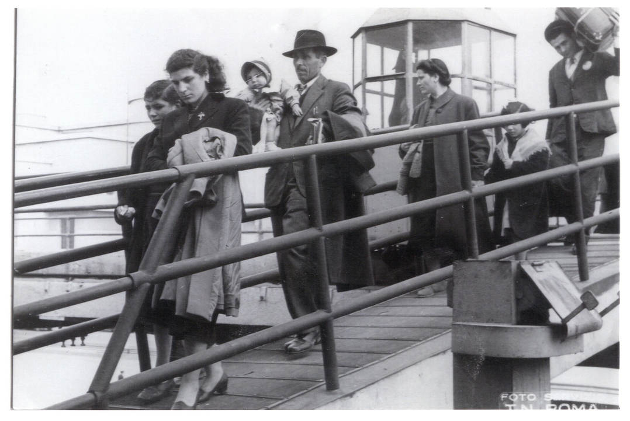
Waves of Italian Immigration
Arrived in Canada and the United States in two waves during the late nineteenth and twentieth centuries.
Driven by economic opportunities.
First wave- Early 1900s to World War I
Second wave- Post World War II
Memories of Brantford- Stephanie Family arrives at Pier 21 from Naples

Slide 5
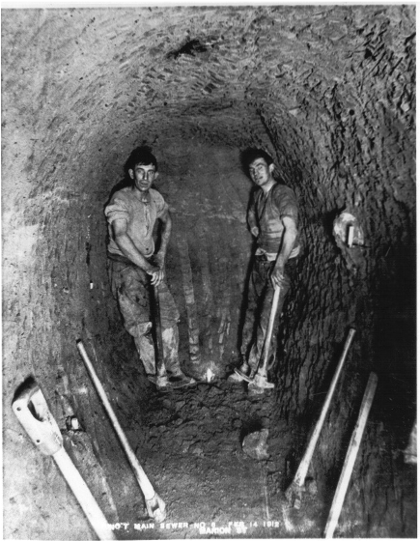
First Wave of Italian Immigration
Migrants arrived in search of employment.
Employment opportunities included:
Building transcontinental railroads
Work on grain elevators
Work in mines
Work as tradesmen
Work was harsh and often dangerous
Faced discrimination
Italian Workers constructing a sewer (MHSO Collection, 1896-1914/ITA- 200373), photographer unknown.

Slide 6
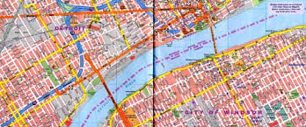
Italian Immigrants in Ontario
60,000 Italian immigrants settled in Ontario
Many immigrants came for temporary positions
Immigrants often moved to cities like Windsor due to its proximity to Detroit
Worked in the automotive and construction industries.
Often started their own businesses

Slide 7
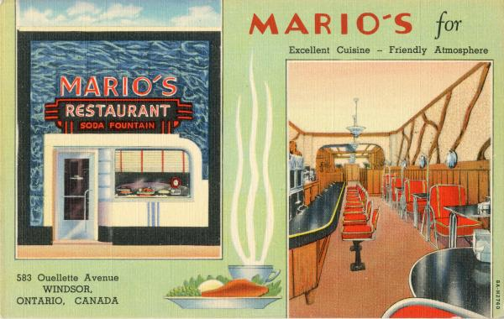
Community and Culture
Community life developed through:
Family networks
Shared culture
Small businesses
Mario's Restaurant, Windsor, Ontario, Canada (1935). Postcard from Mike Skreptak Collection. Retrieved from Leddy Library, University of Windsor.

